Slide 1
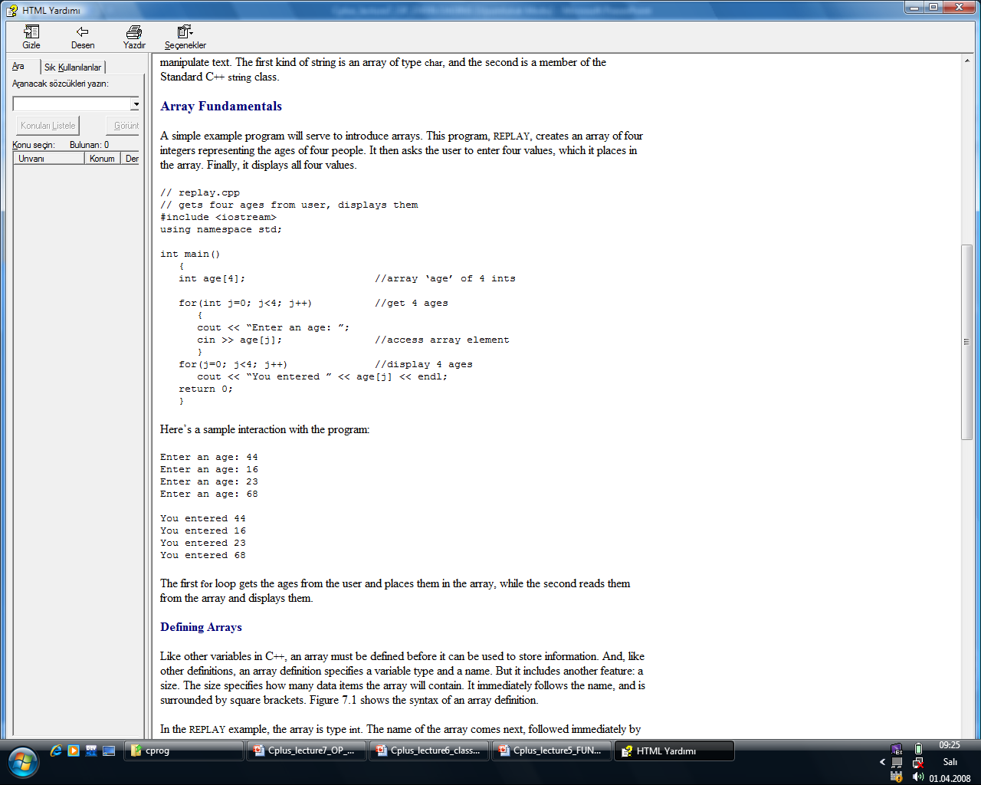
Array Fundamentals
A simple example program will serve to introduce arrays. This program, REPLAY, creates an array of four integers representing the ages of four people. It then asks the user to enter four values, which it places in the array. Finally, it displays all four values.

Slide 2
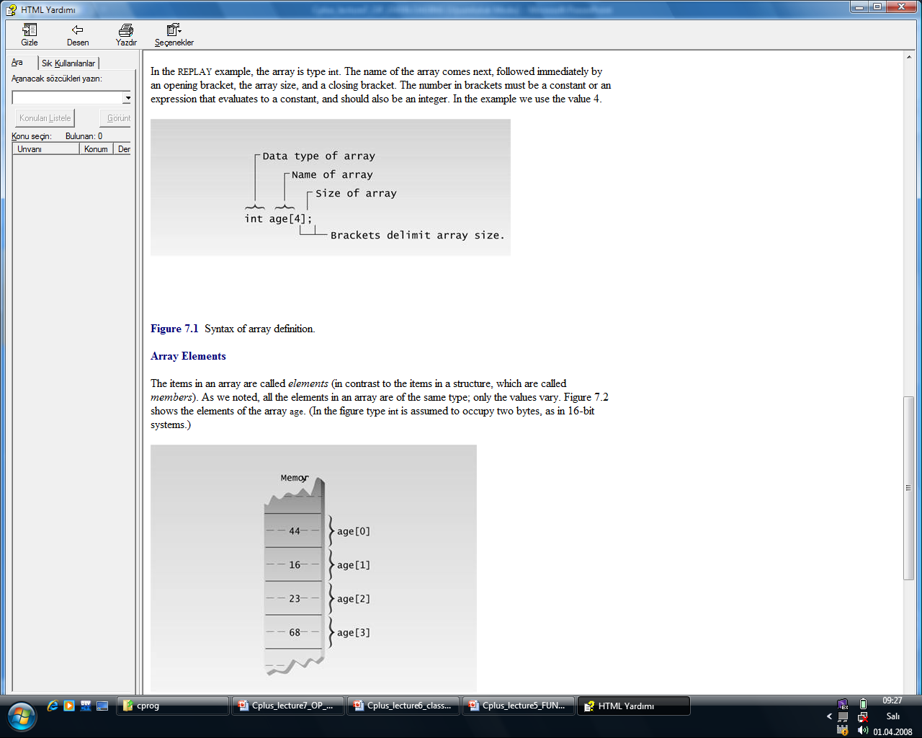

Slide 3
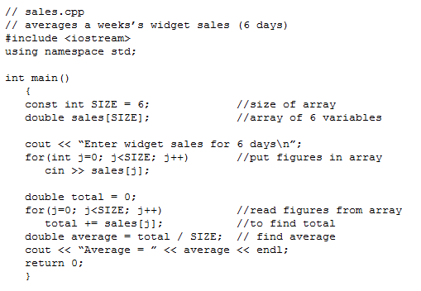

Slide 4
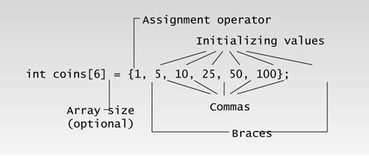

Slide 5
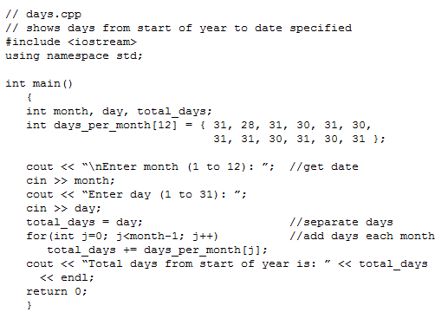

Slide 6
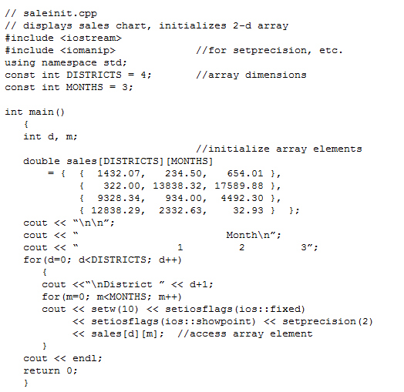
{ 1432.07, 234.50, 654.01 }

Slide 7
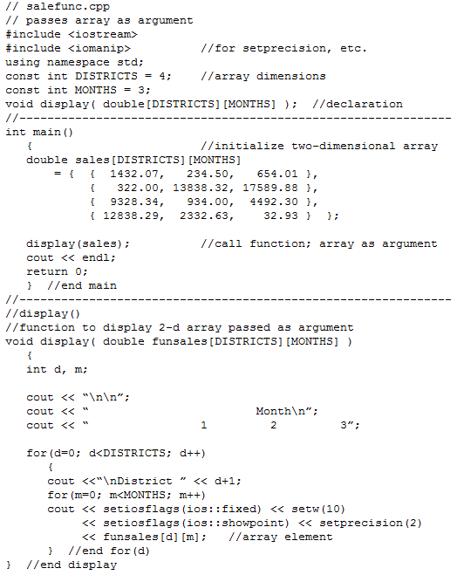

Slide 8
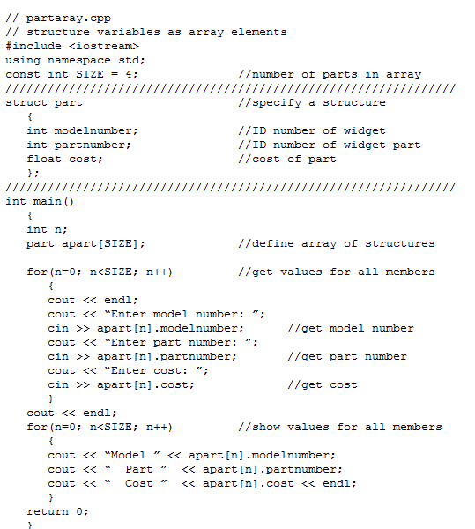

Slide 9
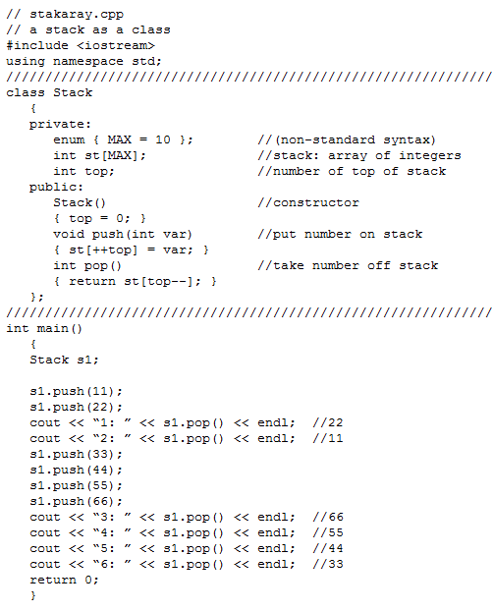

Slide 10
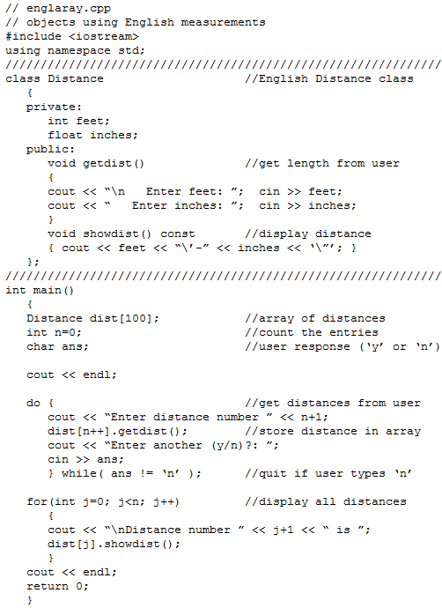

Slide 11
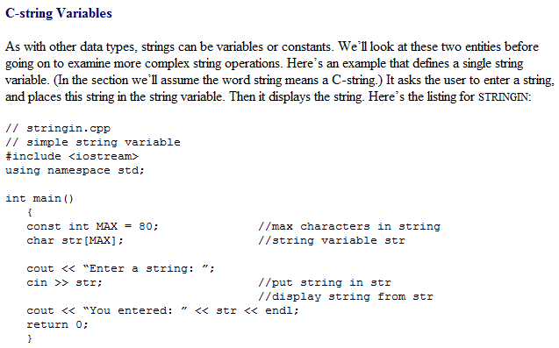

Slide 12
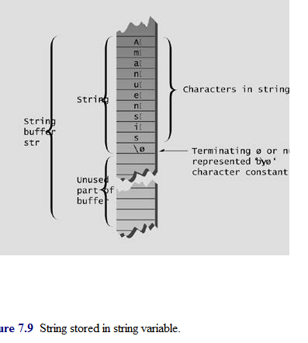

Slide 13
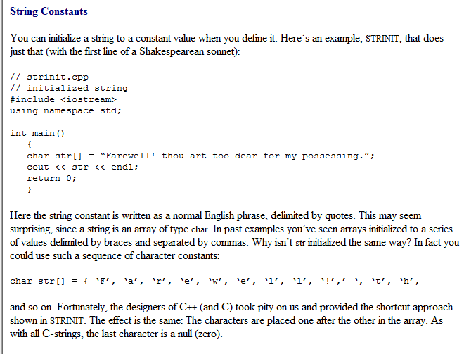

Slide 14
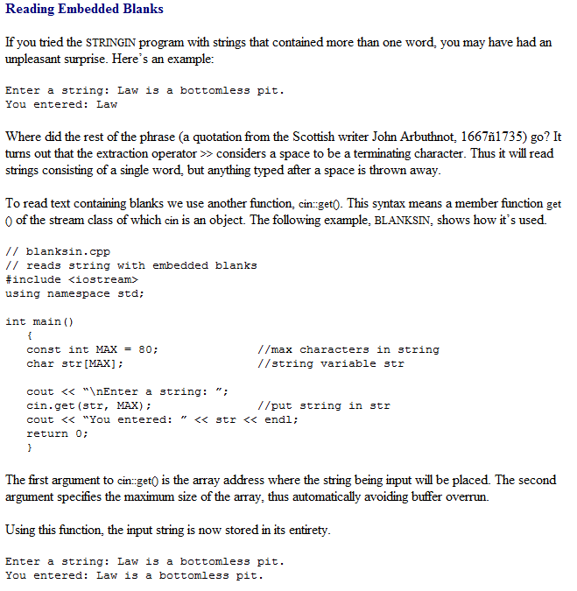

Slide 15
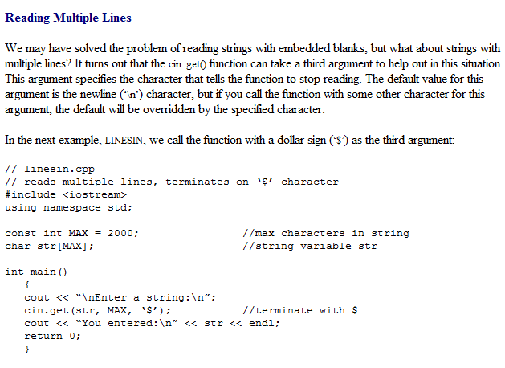

Slide 16
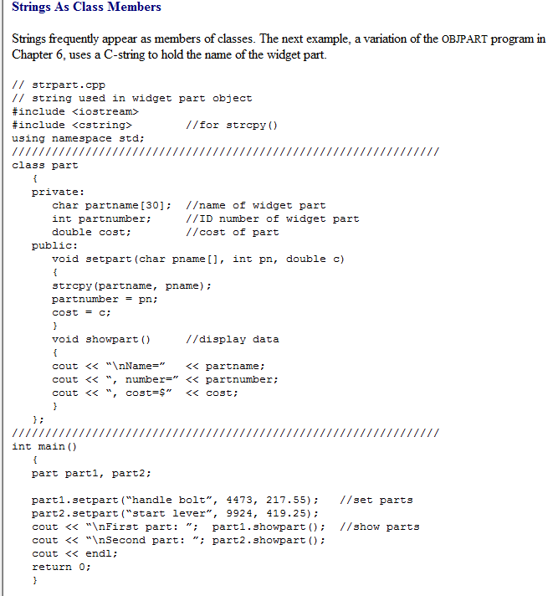

Slide 17
The Standard C++ string Class
Standard C++ includes a new class called string. This class improves on the traditional C-string in many ways.
For one thing, you no longer need to worry about creating an array of the right size to hold string variables.
The string class assumes all the responsibility for memory management.
Also, the string class allows the use of overloaded operators, so you can concatenate string objects with the + operator: s3 = s1 + s2.
There are other benefits as well. This new class is more efficient and safer to use than C-strings were.

Slide 18
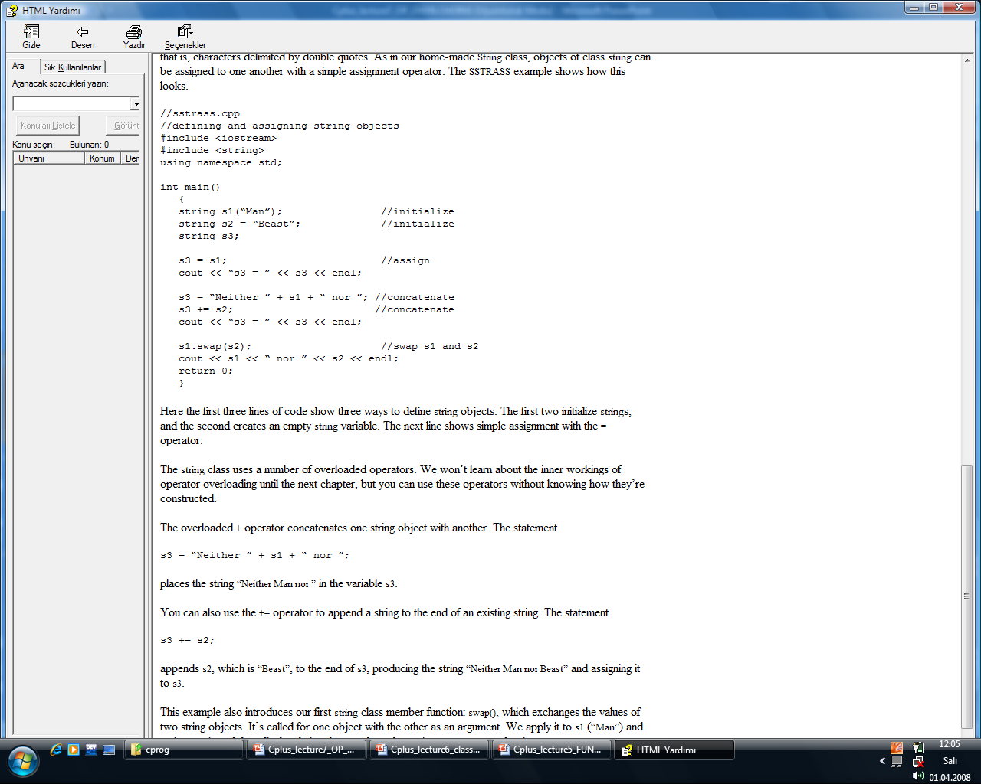

Slide 19
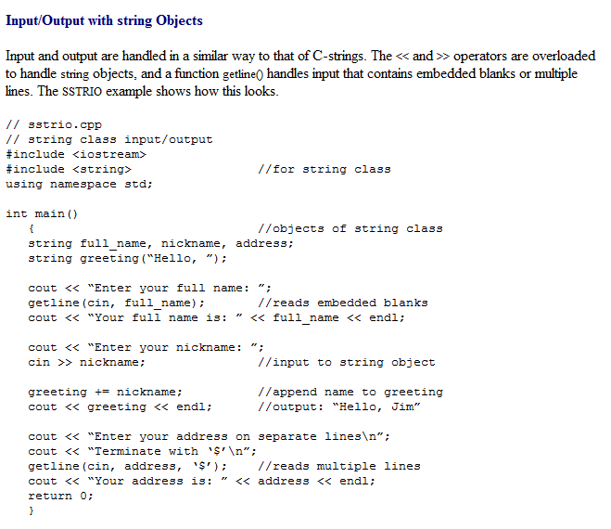

Slide 20
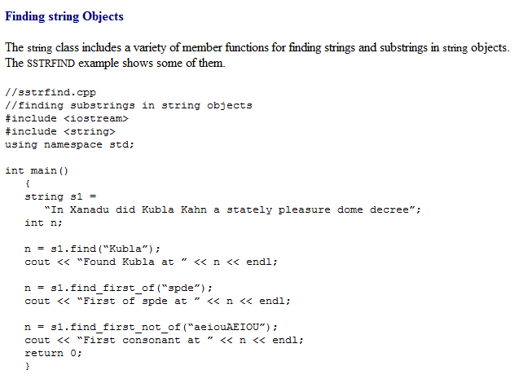

Slide 21
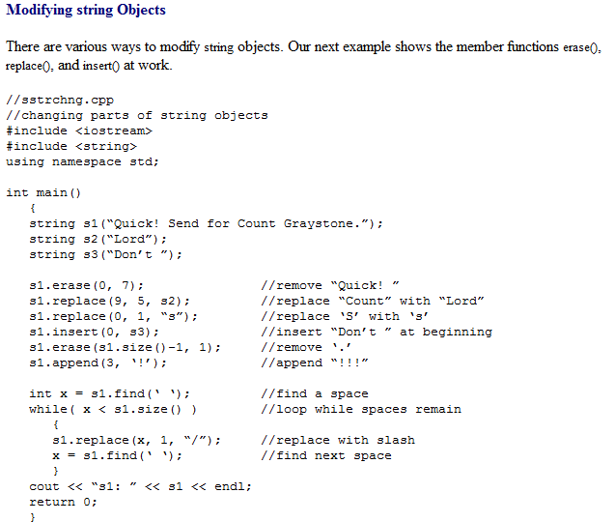

Slide 22
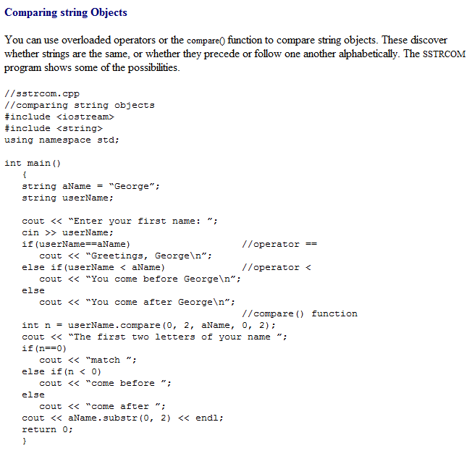

Slide 23
